Slide 1

Apple Stock Price Analysis & Forecast
Apple Stock Price Analysis & Forecast
Mentor :
Srinivas Alapati
Group 3 Team Members :
Srushti Prabhugouda Goudar
Bibi Zainab Shuttari
Shubham Ravindra Vishvkarma
Pranav Sachin Ransing
Sai Sri Siddha Regilla
Amit Kumar Singh

Slide 2
INTRODUCTION
A market where shares are publicly issued and traded is known as share market.
Implementing the concept of algorithm trading, which uses automated, pre-programmed trading strategies to predict stock prices.
Time series forecasting (predicting future values based on historical values) applies well to stock forecasting .
We are going to implement multiple types of algorithms because different types of data requires different types if techniques.
Decided to implement a simple User Interface to operate this whole process for users so to make prediction for future share prices.

Slide 3
NEED OF PROJECT
The stock market is known for being volatile, dynamic and nonlinear.
Accurate stock price prediction is extremely challenging because of multiple factors.
But all of this also means that there’s a lot of data to find pattern in.
So, we keep exploring analytics techniques to detect stock market trends.
So, they can be analysed as a sequence of discrete-time data.
Despite the volatility, stock prices aren’t just randomly generated numbers.

Slide 4


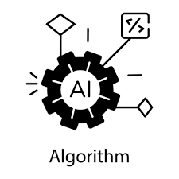

METHODOLOGY
Libraries
Pandas, Numpy, Sklearn,
Tensorflow etc.
Python Language
Python is a rich language for Data Science and AI.
Algorithm
Long Short Term Memory(LSTM)
Autoregressive integrated moving average (ARIMA)
Seasonal Autoregressive Integrated Moving Average(SARIMA)
Deep Learning Models(RNN,GRU,LSTM)
Streamlit UI
Provided User Interface using
Streamlit.

Slide 5
STEPS PERFORMED
Importing and Cleaning Data (EDA)
Split the Data into training / test sets
Making Predictions
Evaluating and Improving Predictions
Model Deployment and User Interface Development

Slide 6
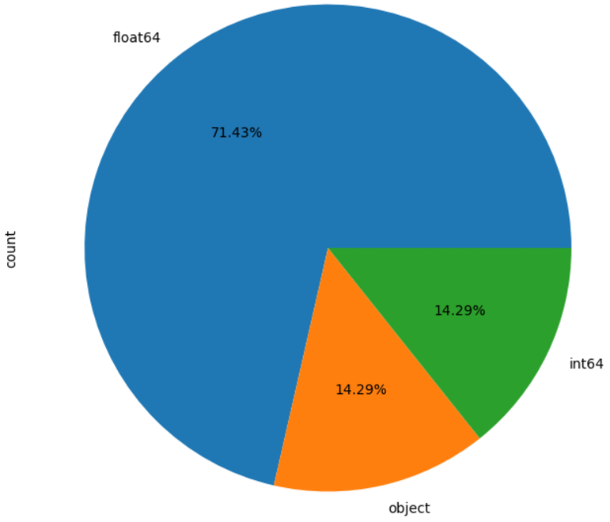
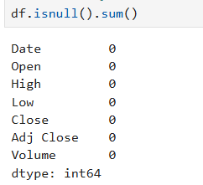
EDA
Data Types
Null Values in the Data

Slide 7
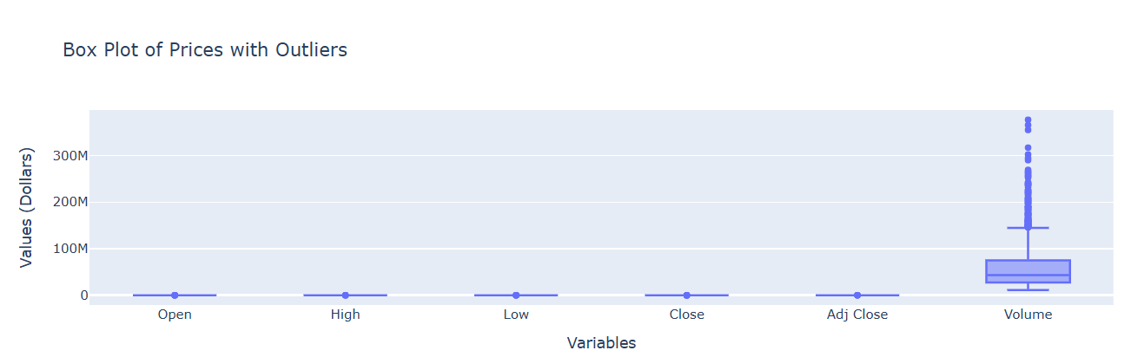
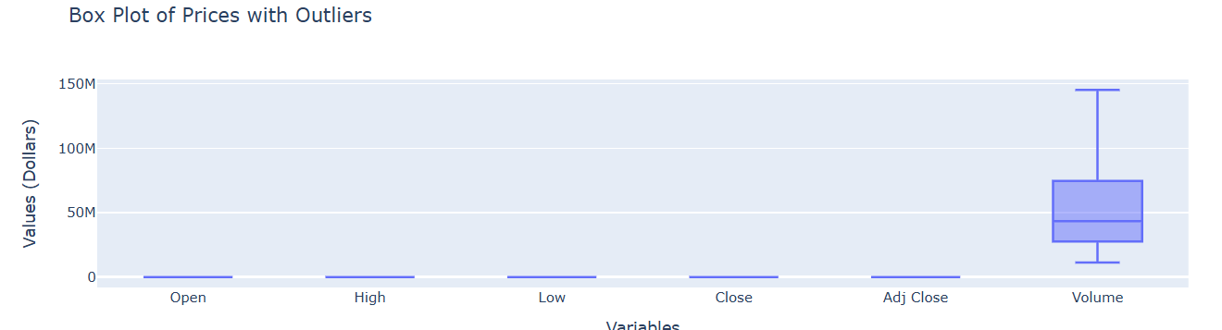
EDA
Outliers Before Treatment
Outliers After Treatment

Slide 8
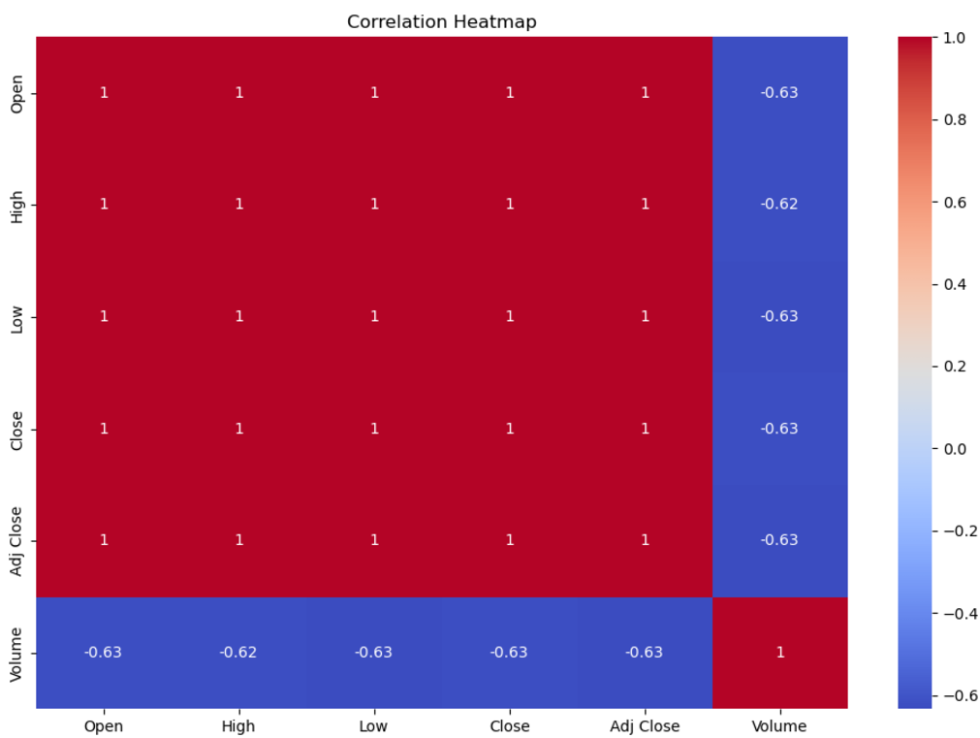
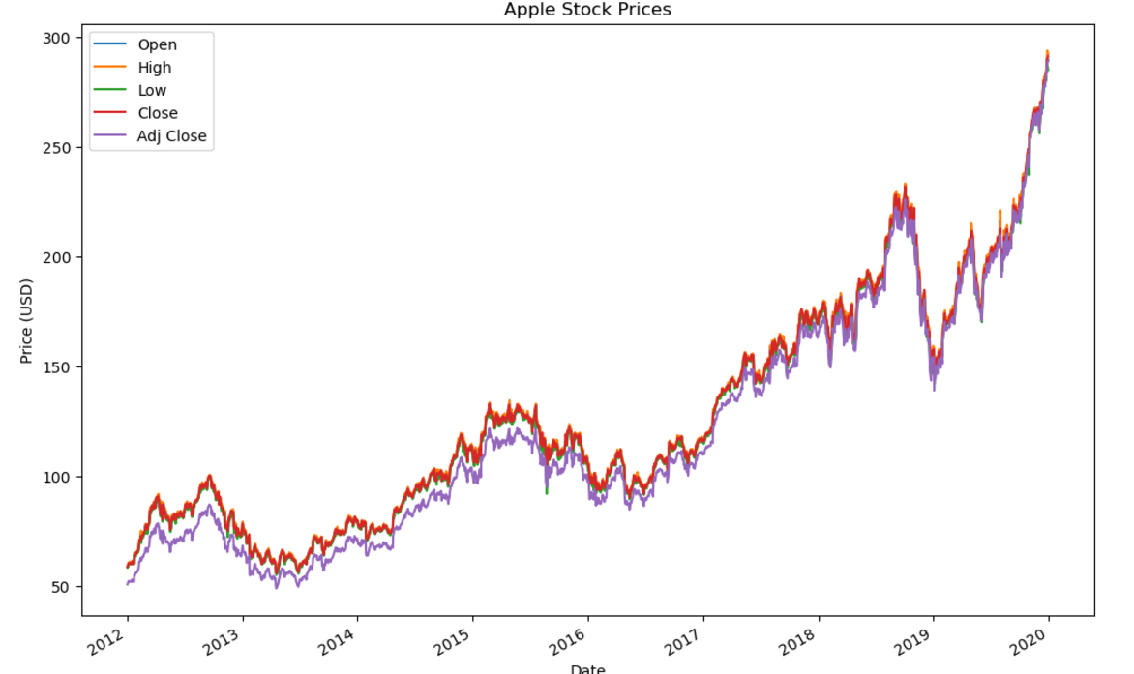
EDA
Correlation Heatmap : All columns show linear correlation except volume.
Stock Prices Overtime : Stock prices overtime shows increase.

Slide 9
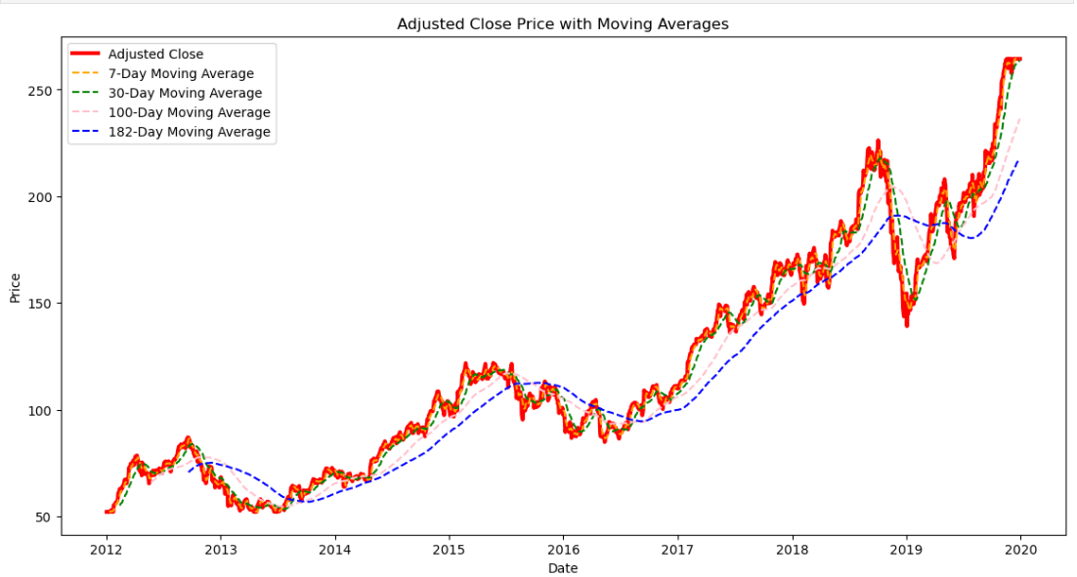
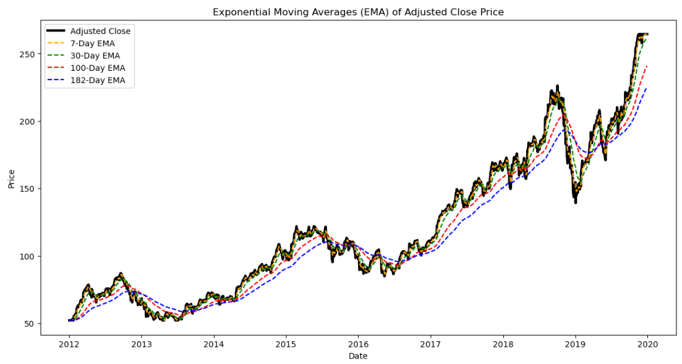
EDA
Moving average of Adjusted Close Price
Exponential Moving average of Adjusted Close Price

Slide 10
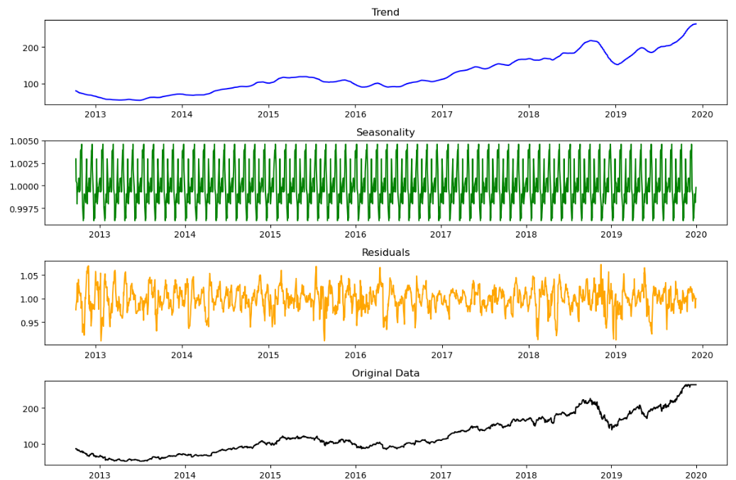
EDA
Multiplicative Decomposing Time Series for Trend, Seasonality, and Residuals

Slide 11
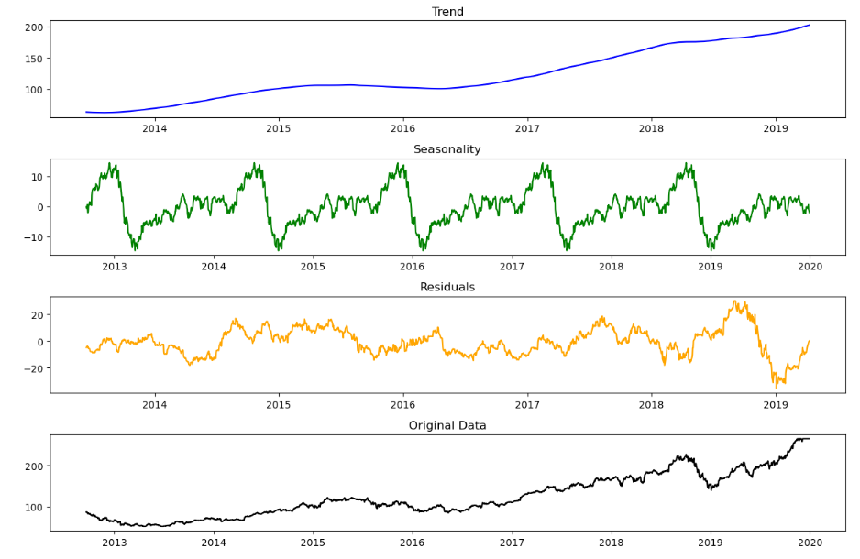
EDA
Additive Decomposing Time Series for Trend, Seasonality, and Residuals

Slide 12
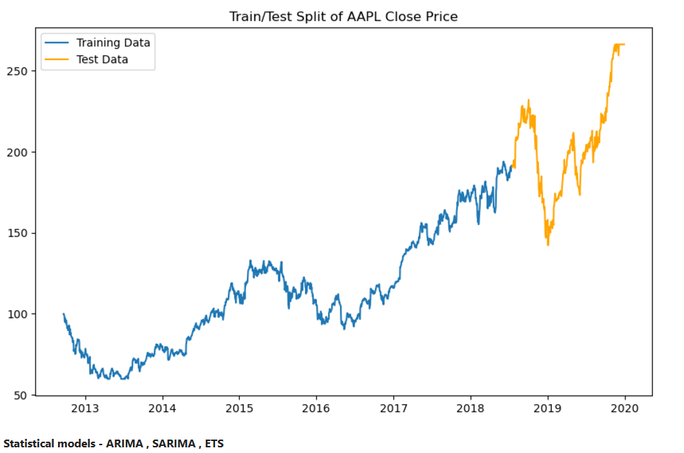
TRAINING/TEST SPLIT
Graph showing Training and Test Split

Slide 13
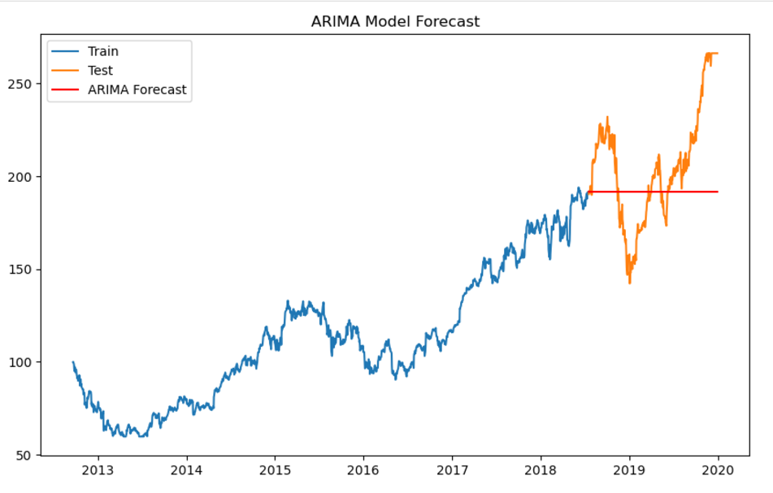
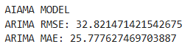
MODEL BUILDING AND EVALUATION
1. ARIMA MODEL

Slide 14
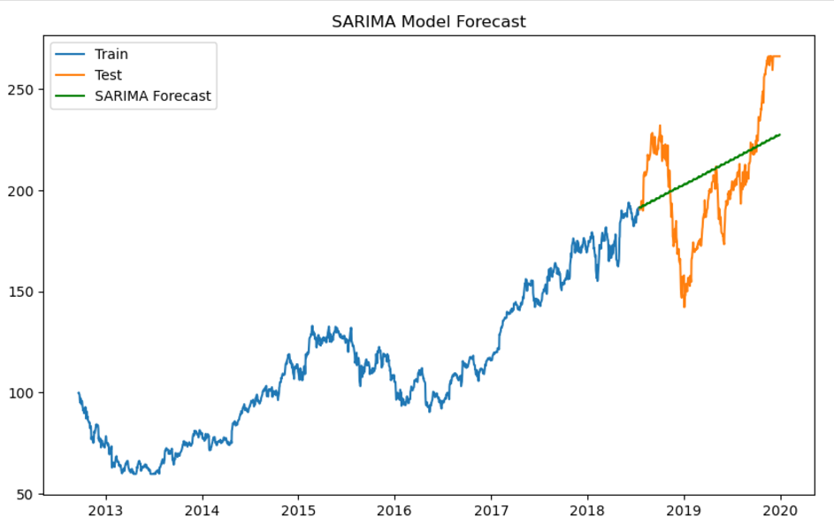
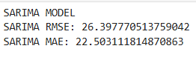
MODEL BUILDING AND EVALUATION
2. SARIMA MODEL

Slide 15
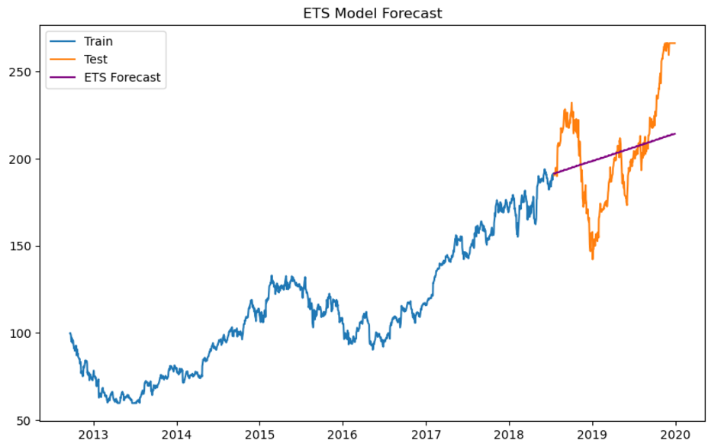
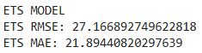
MODEL BUILDING AND EVALUATION
3. ETS - Exponential Smoothing Model

Slide 16
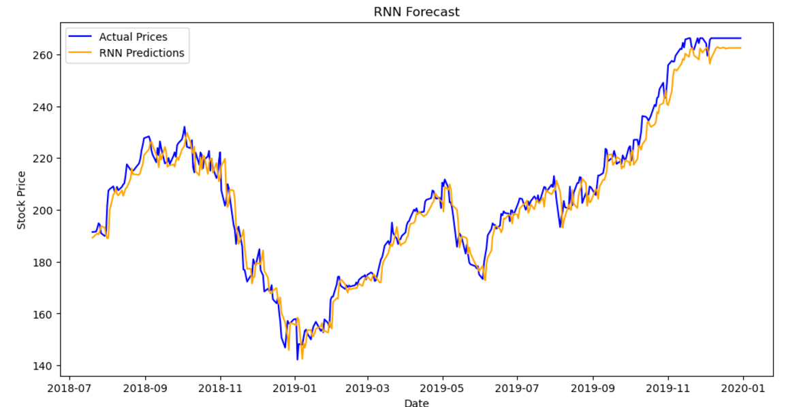
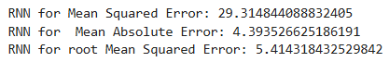
MODEL BUILDING AND EVALUATION
4. RNN - Recuurent Neural Network Model

Slide 17
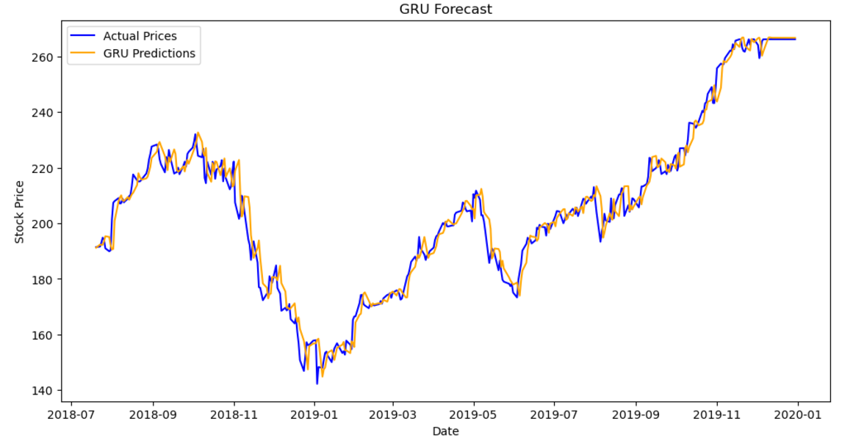
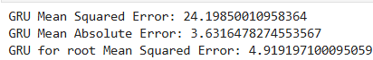
MODEL BUILDING AND EVALUATION
5. GRU - Gated Recurrent unit Model

Slide 18
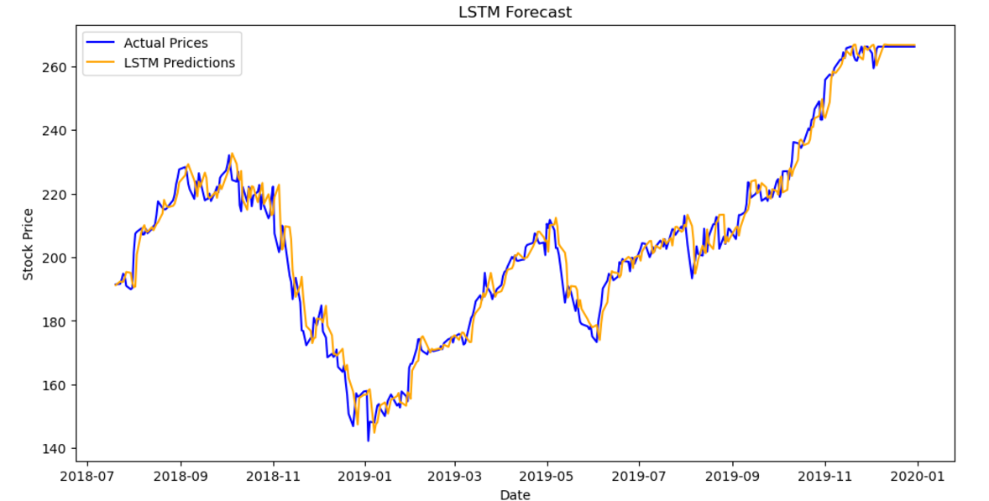
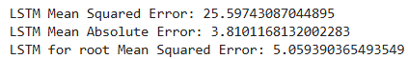
MODEL BUILDING AND EVALUATION
6. LSTM Model

Slide 19
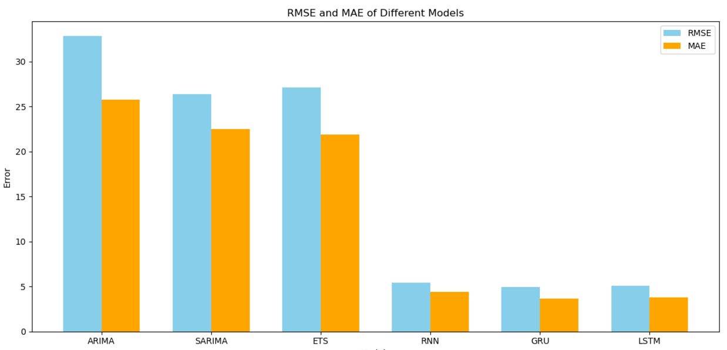
MODEL BUILDING AND EVALUATION
Selecting LSTM as best Model based on RMSE and MAE.

Slide 20
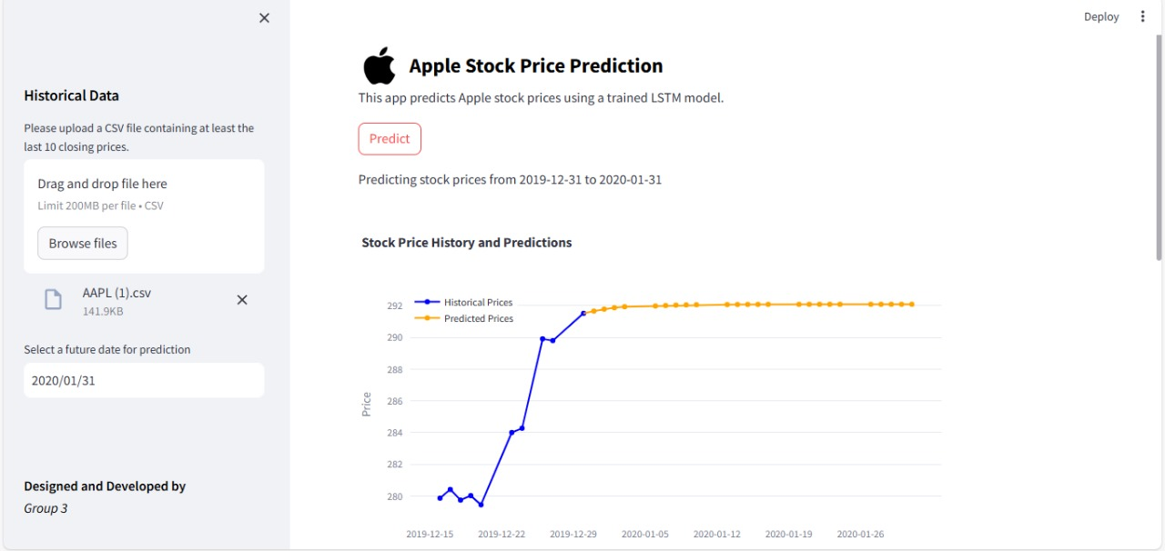
DEPLOYMENT UI
Section to upload data file
Predicted Price
Historical Price
Future Date for Selection

Slide 21
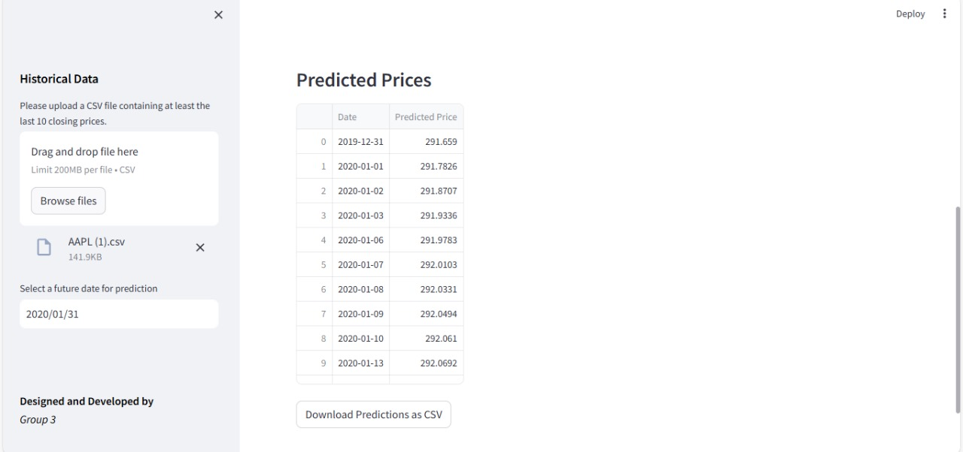
DEPLOYMENT UI
Predicted Prices for future Dates
Predicted Price for future dates

Slide 22
CHALLENGES
Data Preprocessing Challenges
Dealing with timely streams of active financial data.
Interpolation of missing or outlying data points.
Validating and making sure of consistency in the data.
2. Model Deployment Woes
Choosing the right M.L. algorithm.
Finding the best hyper parameter for predictions.
3. Streamlit Visualization Issues
Working with voluminous data sets.
Software and Library version mismatch.

Slide 23
ADVANTAGES
1. Identifying Patterns : help in identifying trends, seasonality, and other patterns in data.
2. Making Predictions : help predict future values based on historical data. This can be used for business planning, stock market analysis, and more.
3. Understanding Data : helps to understand the underlying structure of data.
4. Assessing Risk : help to assess and manage risk associated with factors like market fluctuations or supply chain disruptions.

Slide 24
Thank you

